Slide 1

Job Path...
“Your Roadmap to Career Success”
" From building knowledge to landing your dream job,
we' re with you at every step — guiding,
supporting, and empowering your career journey."
|

Slide 2
01
Job Path
Introduction
Table Of
Content
02
About the App
03
Key Features
04
App Screens Showcase
|

Slide 3
Problem Statement
Job Path
Lack of guidance in matching skills to suitable roles
Difficulty managing certifications and resumes
01 Many users acquire skills but are unaware of how those skills translate into real- world job roles, leading to confusion and missed opportunities.
03 Users often struggle to organize and update multiple certificates and resume versions, resulting in inefficiency and unprofessional
presentation during applications.
02
Limited awareness of current job trends and hiring needs
Without access to real-time industry trends and in-demand skills, job seekers may prepare for outdated roles, affecting their chances of employment.
04
No platforms for career preparation guidance
Career preparation tools, learning platforms, and job portals are often disconnected, forcing users to switch between services, causing delays and poor user experience.
|

Slide 4
Job Path
Validating certifications for credibility
The app analyzes the user’s existing skills and qualifications to recommend relevant job roles or career paths that align with industry demands and individual strengths.
About the App
Suggesting career roles based on skillsets
It provides a clear, step-by-step visual guide showing the progression from the current skill level to the desired role, helping users understand what to learn and how to grow.
Job Path offers a seamless experience transforming the journey from learning to employment into a structured, guided, and empowering process.
Offering visual roadmaps for better planning
Users can easily create, update, and organize multiple resumes with built-in templates and formatting tools, ensuring a professional presentation tailored for each job application.
|

Slide 5
Key Features
Job Path
Skill Match Analysis
Analyzes skills (Java, Python) against job roles.
Suggests areas to learn next (e.g., Test automation, C#, CI/CD pipelines).
Career Roadmap
Visualizes skill connections (Java → Python → JavaScript). Recommends roles: AI Architect (33%), Software Engineer (29%), etc.
Job Recommendations
Recent hirings (e.g., Software Engineer at IO Global, ₹57.5k-₹125k).
Job categories: Software Development, Data & Analytics, Cybersecurity, etc.
|

Slide 6
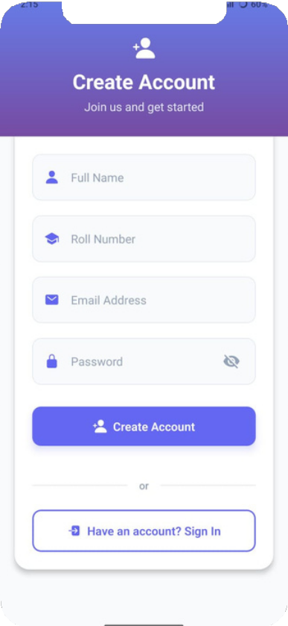
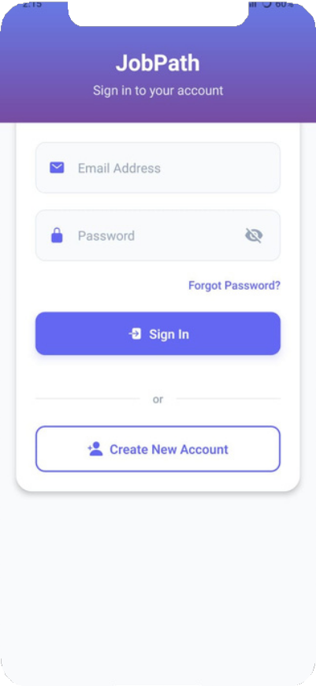
App Screens
Job Path
✨ Signup Page
New users can easily create an account by providing basic details such as name, email, and password. The form is clean, responsive, and guides users through each step, making the signup process quick and beginner-friendly.
🔄 Login Page
Returning users can securely log in with their registered email and password. The system also supports password recovery options, ensuring a safe and hassle-free re-entry into the app.
|

Slide 7
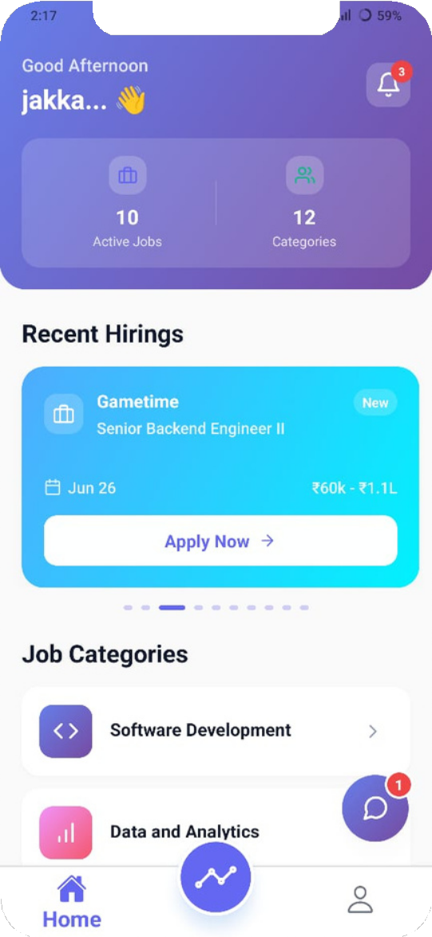
Home Page
Job Path
This screen from the JobPath mobile app serves as the home page, designed to give users a quick overview of current job opportunities and categorized career paths.
At the top, it features a "Recent Hirings" section showcasing highlighted job postings with complete details of posting date, salary range, and an easy-to-tap "Apply Now" button.
Below that, the "Job Categories" section neatly organizes job roles into major tech domains such as Software Development, Data and Analytics, IT Management, Cybersecurity, Cloud & DevOps, and User Experience & Design, each represented with intuitive icons.
|

Slide 8
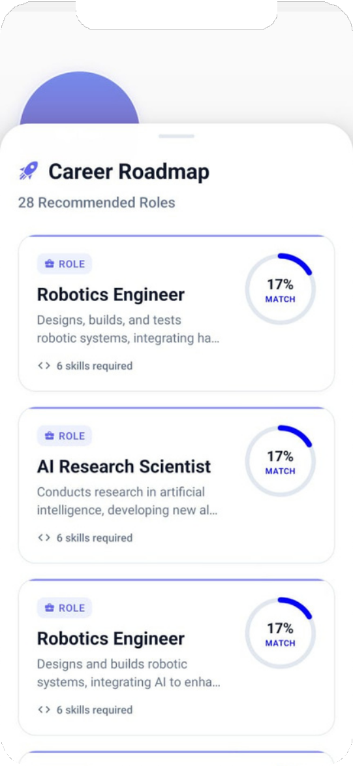
Your Career RoadMap
Job Path
This screen represents a personalized career roadmap based on the user's selected skill.
It displays a list of recommended job roles that align with the user’s skillset, along with a match percentage indicating how well the user's profile fits each role.
This helps guide users toward relevant career paths such as AI Architect, Software Engineer, and Application Developer based on their expertise.
|

Slide 9
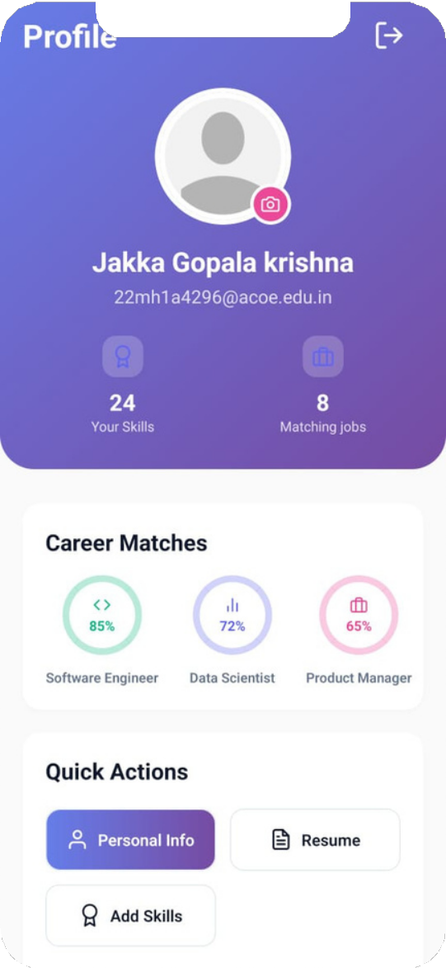
Profile Section
Job Path
This screen represents the Profile section of the JobPath app, where users can view and manage their personal career information.
It displays the user's name and email ID prominently, along with quick-access buttons to three main areas: Personal Information, Resume, and Skills and Certifications.
These options allow users to update their details, upload or edit their resume, and list relevant skills or achievements.
|

Slide 10
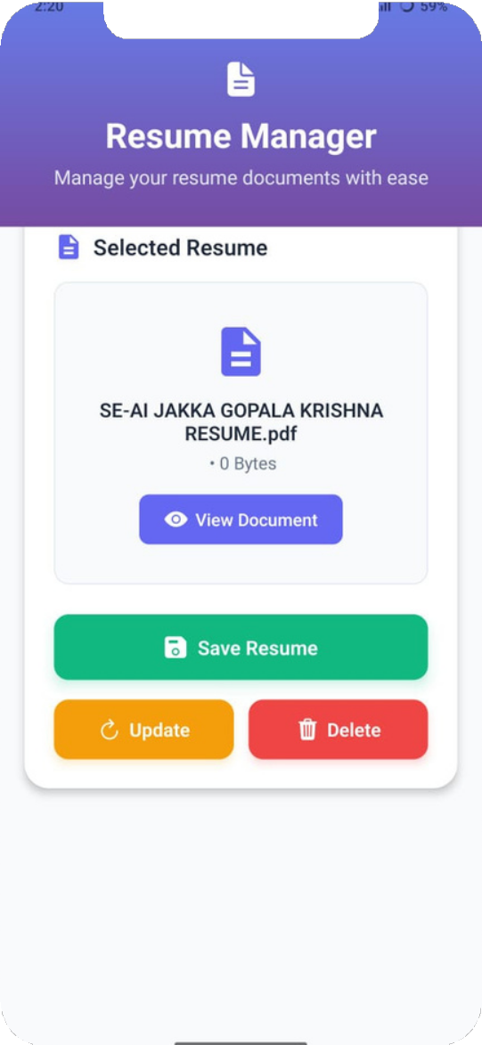
Resume
Job Path
This screen represents the Resume Management section of the JobPath app, where users can upload, view, and manage their resume files.
These options allow users to easily keep their resume up to date, replace older versions, or remove files if needed.
| 10

Slide 11
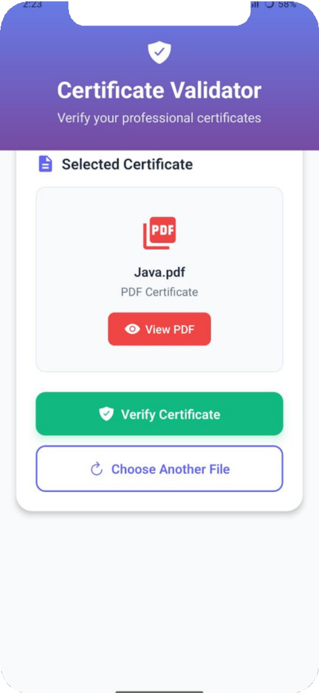
Certificate Validator
Job Path
This screen represents the Certificate Validator section of the JobPath app, where users can verify their professional certificates.
It allows the user to upload a PDF certificate file.
Once uploaded, users can click on the “Verify Certificate” button to initiate validation, confirming the authenticity or relevance of the certificate.

Slide 12
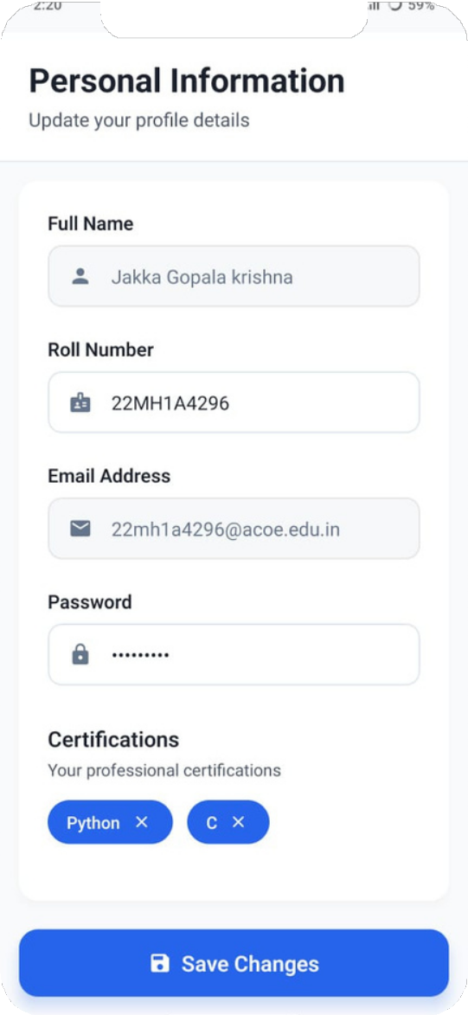
Personal Information
Job Path
This screen represents the Personal Information section of the JobPath app, allowing users to view and update their profile details.
It includes editable fields such as Full Name, Roll Number, Email Address, and Password, providing users full control over their basic account data.
At the bottom, there's a Certifications area that displays the user’s professional skills (e.g., Python, C), which can be updated or removed as needed.

Slide 13


